Slide 1
Prices Server
Usama Alshahabi
Abubakr Almostafa
Ahmad Hamam

Slide 2
Prices Server
On Server:
create Implementation
Rebind
Wait
On Client:
create interface
Lookup & cast
Submit new sales
Get Predicted (New) Prices
Get Current Prices on every new day

Slide 3
Remote Interfaces
On interface:
void Submit (double BuaghtsCount,int Type)
prices GetPridectedPrice ()
prices GetCurrentPrice()
On prices:
double p; //Platinum
double g; //Gold
double s; //Silver

Slide 4
Implementation
public class Implementation extends java.rmi.server.UnicastRemoteObject implements Interface{
double Current_PlatinumPrice=10000;
double Current_GoldPrice=1000;
double Current_SilverPrice=100;
Semaphore SharedSem;
Buffer SharedBuffer;
public Implementation() throws java.rmi.RemoteException{
super();
SharedSem=new Semaphore(1);
SharedBuffer=new Buffer(10000,1000,100);
}
}

Slide 5
Buffer
public class Buffer {
double Pridected_PlatinumPrice;
double Pridected_GoldPrice;
double Pridected_SilverPrice;
public Buffer(double P,double G,double S){
Pridected_PlatinumPrice=P;
Pridected_GoldPrice=G;
Pridected_SilverPrice=S;
}
public void set(double Count,int Type){
if(Type==0)
Pridected_PlatinumPrice*=(Count*0.1+1);
else if(Type==1)
Pridected_GoldPrice*=(Count*0.01+1);
else
Pridected_SilverPrice*=(Count*0.001+1);
}
public prices get(){
prices Prices=new prices(Pridected_PlatinumPrice,Pridected_GoldPrice, Pridected_SilverPrice);
return Prices;
}
}

Slide 6
Semaphore
public class Semaphore extends Thread{
int value;
public Semaphore(int i) {
value=i;
}
public synchronized void P(){
if(value<=0)
try{
wait();
}
catch(InterruptedException Exp){
System.out.println(Exp.toString());
}
value--;
}
public synchronized void V(){
value++;//notifyAll();
notify();
}
}

Slide 7
Implementation
public class Implementation extends java.rmi.server.UnicastRemoteObject implements Interface{
public double Submit (double BuaghtsCount,int Type){
Submit_Thread thread=new Submit_Thread(SharedBuffer, SharedSem ,BuaghtsCount,Type);
thread.start();
return 0;
}
public prices GetPridectedPrice () {
prices prices_class=SharedBuffer.get();
return prices_class;
}
public prices GetCurrentPrice(){
prices prices_class=new prices(Current_PlatinumPrice, Current_GoldPrice,Current_SilverPrice);
return prices_class;
}
}

Slide 8
Submit_Thread
Buffer buffer;
Semaphore sema;
public Submit_Thread(Buffer buffer, Semaphore sema, double BuaghtsCount,int Type){
super();
this.buffer=buffer;
this.sema=sema;
this.BuaghtsCount=BuaghtsCount;
this.Type=Type;
}
@Override
public void run() {
sema.P();
buffer.set(BuaghtsCount, Type);
sema.V();
}
}

Slide 9
Client
public class Client{
public static void main(String[] args)
{
Client_Form mm=new Client_Form();
mm.show();
}
}

Slide 10
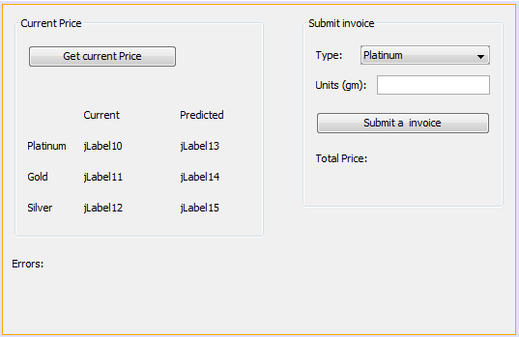
Client Form

Slide 11
Thank you

